Slide 1

Introduction to Supervised Machine Learning
Soumya Banerjee
Notes:
negatvive microbiome periphery clinical infectious disease intra-cellular modelling, bioinformatics, data science

Slide 2
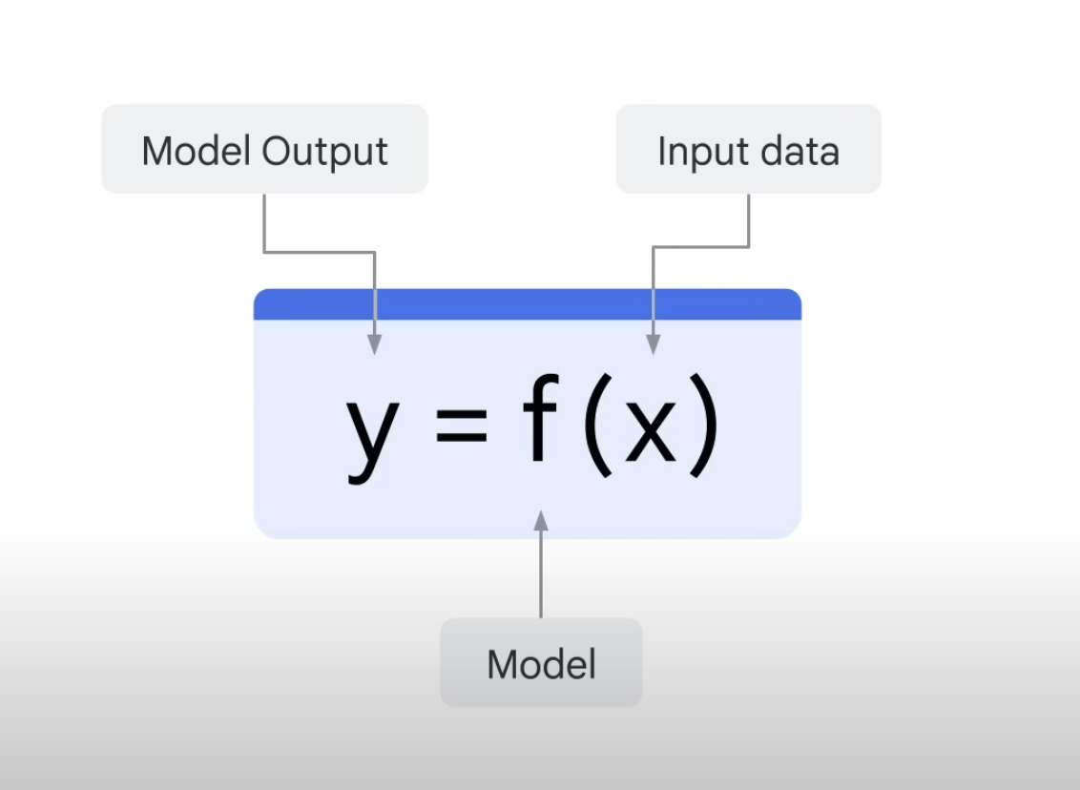
Supervised learning

Slide 3
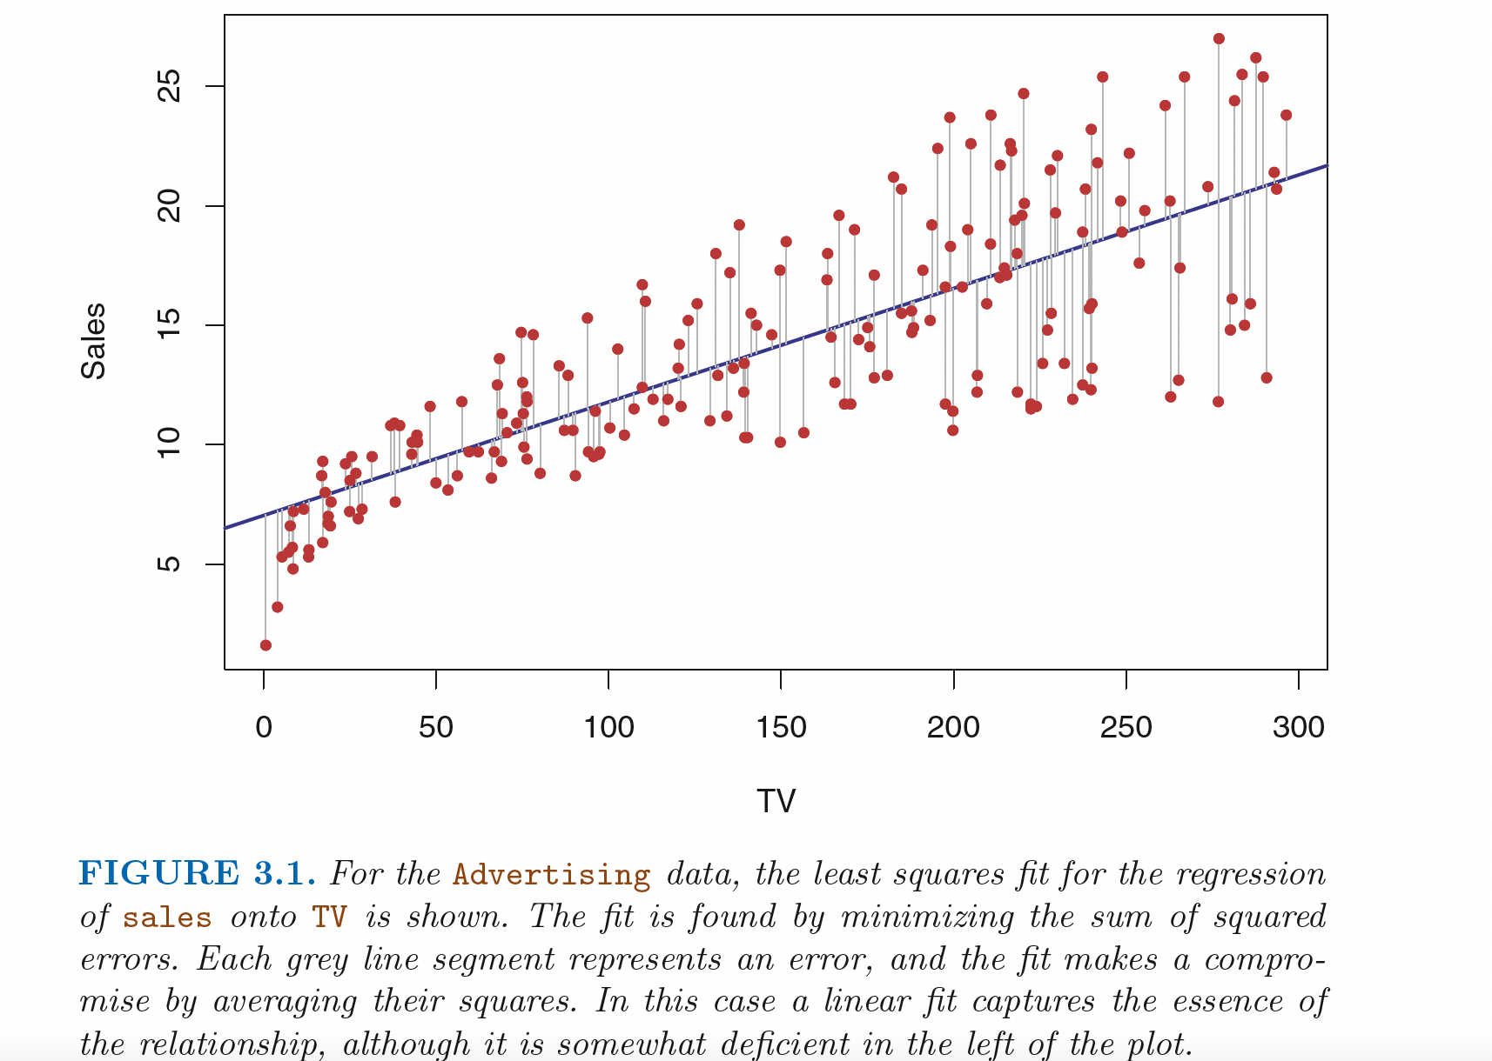
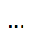
Linear regression
Notes:
I pick those which are consistent
From
~/periphery_project/bioinformatics/microarray_holm_il23/maplot_limma_pbmc_microarray_nick_RAWDATA_REANALYZED_samepatient_onedonorexcluded_usingpca_ALLPROBES_generic_ggrepel.pdf
generated from R ~/periphery_project/bioinformatics/microarray_holm_il23/holm_pbmc_microarray_limma_onedonorexcluded_usingpca_generic.rmd% (re-analyzed from raw data)% plots in right direction (flipped signs), with ggrepel and plots with max probes% plots publication ready plots

Slide 4
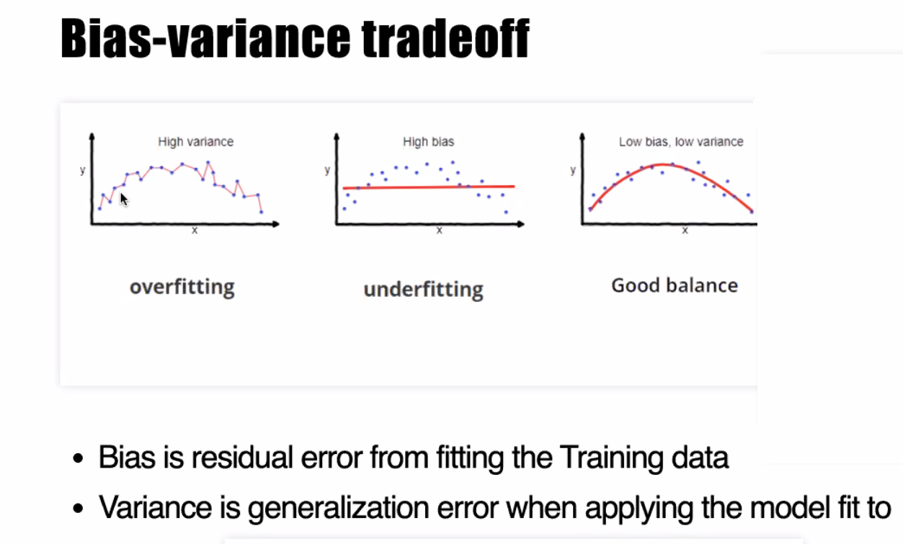
A fundamental concept in machine learning

Slide 5
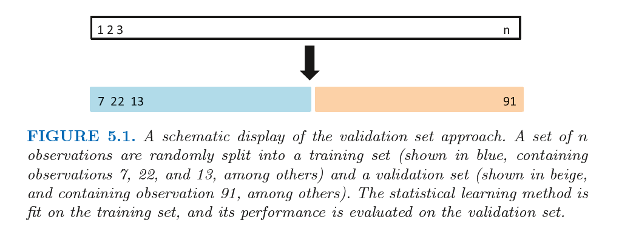
A fundamental concept in machine learning
An Introduction to Statistical Learning with Applications in R

Slide 6
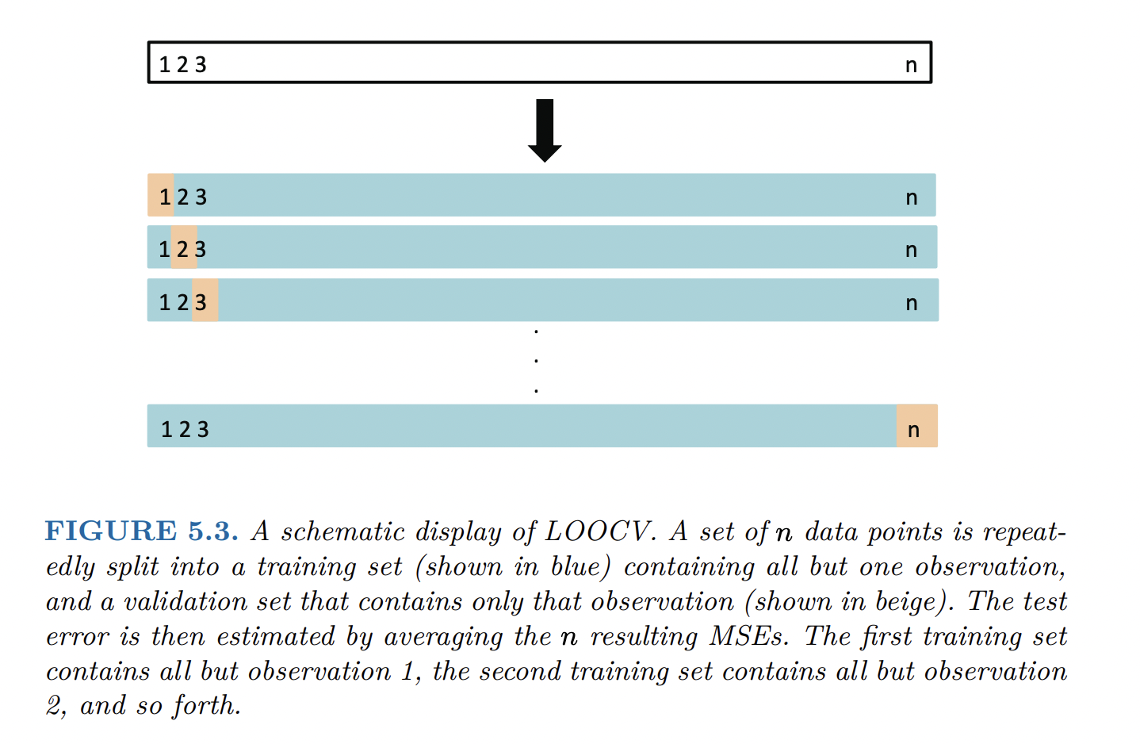
Leave one out cross-validation
An Introduction to Statistical Learning with Applications in R

Slide 7
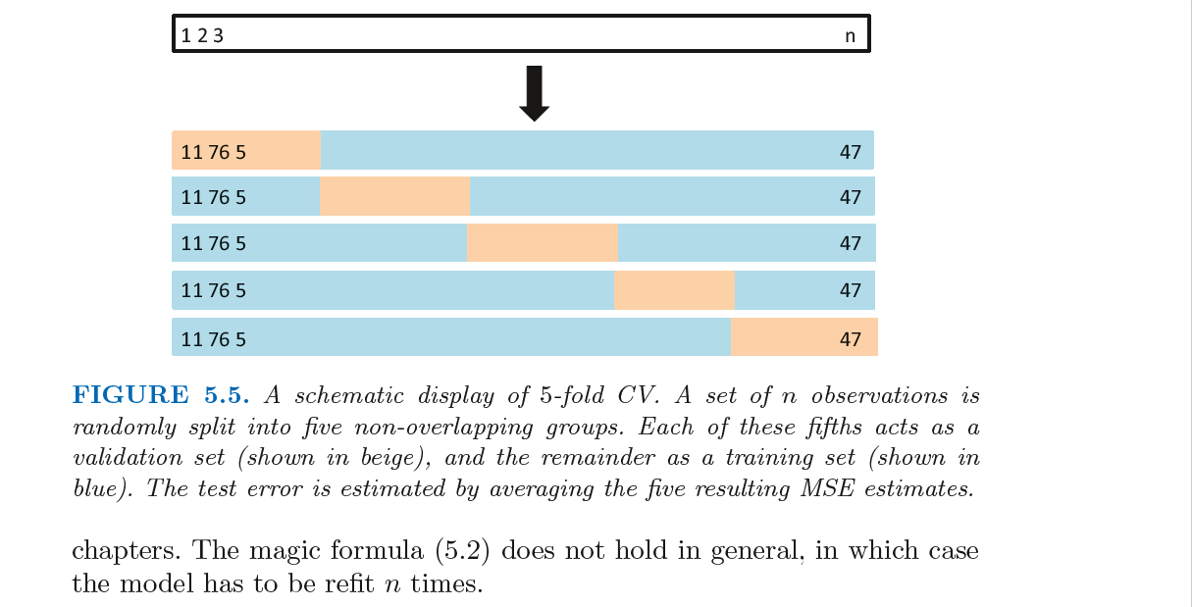
K-fold cross-validation
An Introduction to Statistical Learning with Applications in R

Slide 8
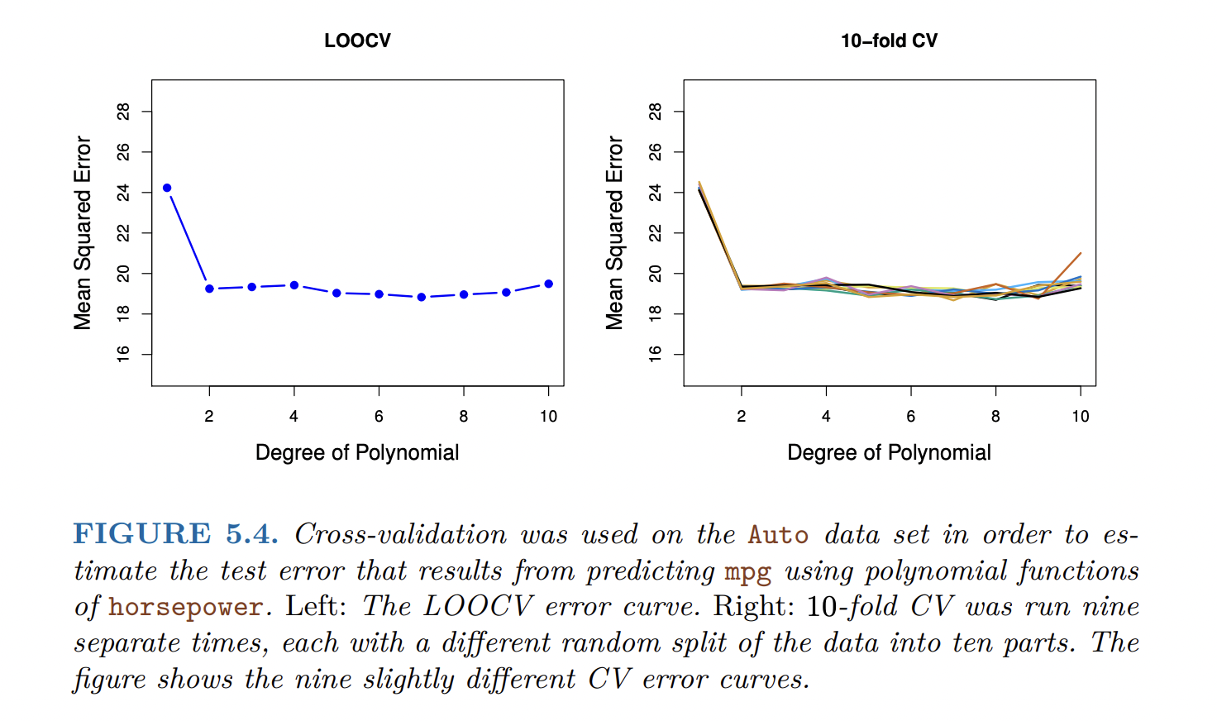
Cross-validation
An Introduction to Statistical Learning with Applications in R

Slide 9
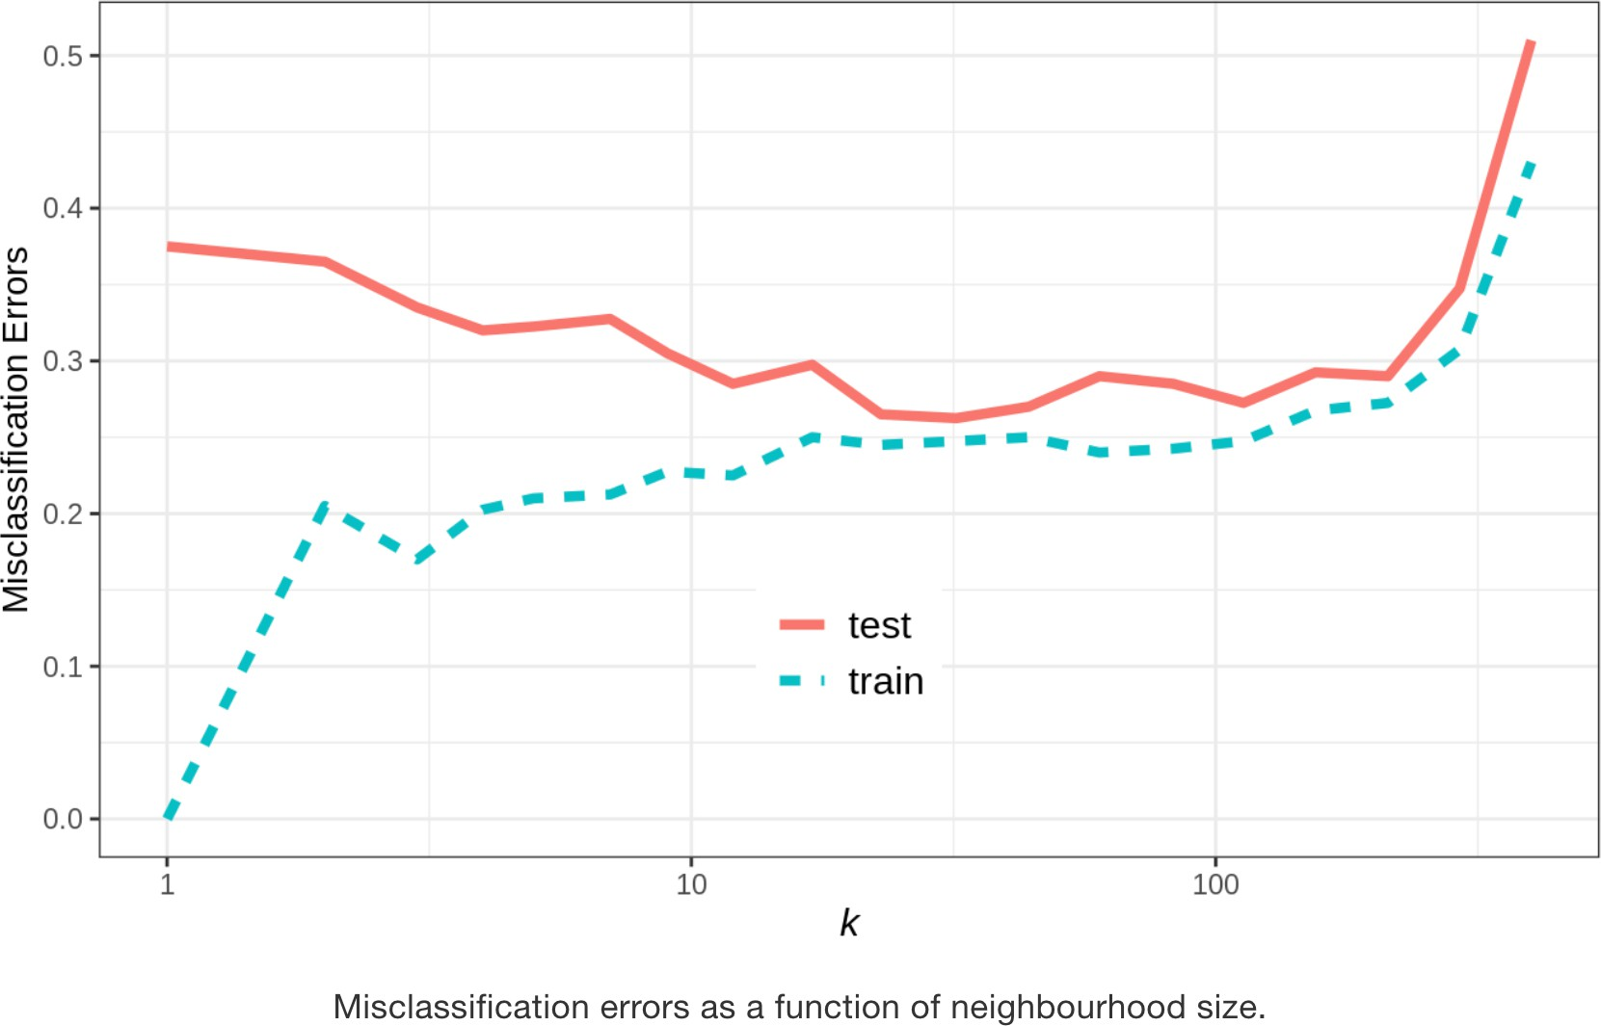
Cross-validation
overfitting
underfitting
Just right

Slide 10
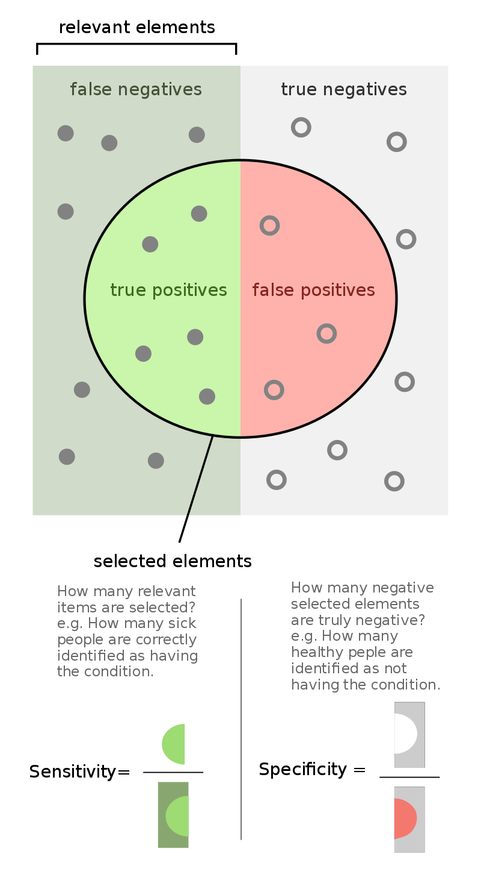
Hypothesis
West et al., Nature Medicine, 2017
Notes:
What happens if we use a simple classifier that just predicts randomly on a disease? For example, say you are trying to predict a particular disease. Each person has for each person. Assume you have features like age, gender and medications. You have to predict whether this patient will get a disease or not. As even the disease occurs in 90% of the population. How should you build your algorithm? What metric should you look at?
Answer: You should look at class-specific error (sensitivity/specificity). This is unbalanced data. Even an algorithm that randomly outputs 1 that is the person has disease, regardless of the input features, would give a 90% accuracy on the data.

Slide 11
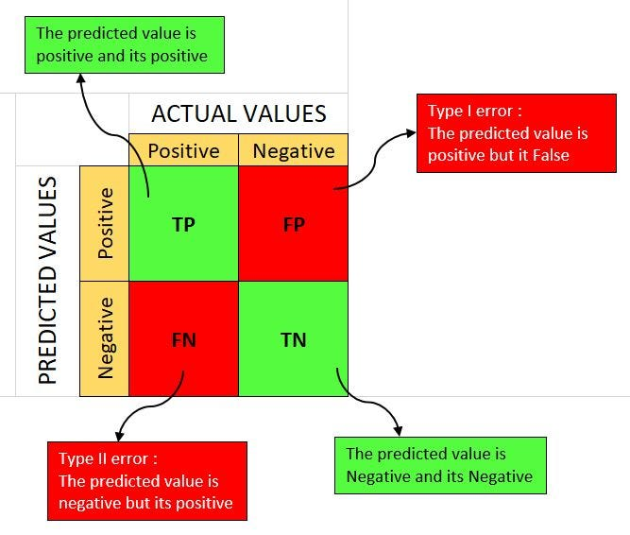
Confusion matrix
West et al., Nature Medicine, 2017

Slide 12
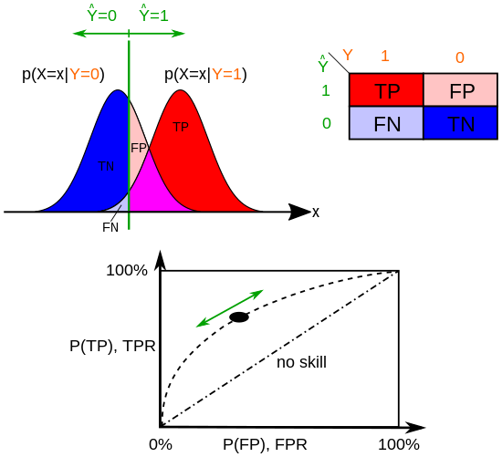
Hypothesis
The probability of a Type 1 error is the significance level (0.05)
https://en.wikipedia.org/wiki/Type_I_and_type_II_errors

Slide 13
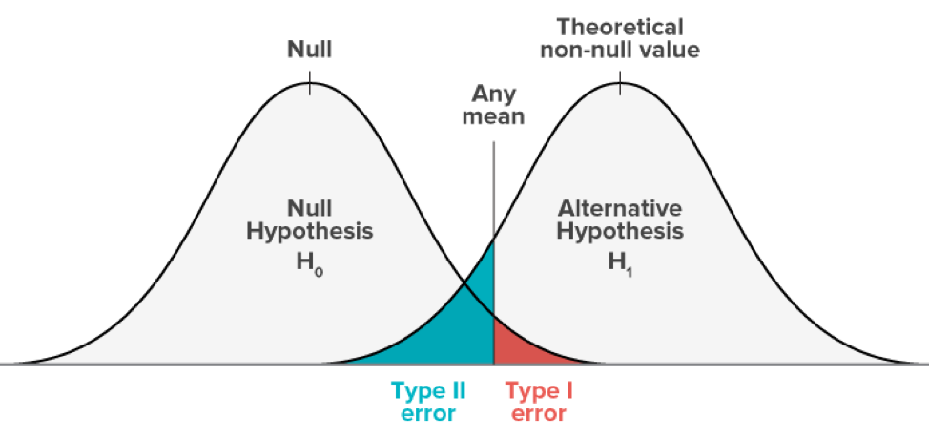
Hypothesis
The probability of a Type 1 error is the significance level (0.05)
https://www.abtasty.com/blog/type-1-and-type-2-errors/

Slide 14
Question
What happens if we use a simple classifier that just predicts randomly on a disease?
For example, say you are trying to predict a particular disease.
Assume you have features like age, gender and medications.
You have to predict whether this patient will get a disease or not.
Assume the disease occurs in 90% of the population.
How should you build your algorithm? What metric should you look at?
Notes:
What happens if we use a simple classifier that just predicts randomly on a disease? For example, say you are trying to predict a particular disease. Each person has for each person. Assume you have features like age, gender and medications. You have to predict whether this patient will get a disease or not. As even the disease occurs in 90% of the population. How should you build your algorithm? What metric should you look at?
Answer: You should look at class-specific error (sensitivity/specificity). This is unbalanced data. Even an algorithm that randomly outputs 1 that is the person has disease, regardless of the input features, would give a 90% accuracy on the data.

Slide 15
Question
What happens if we use a simple classifier that just predicts randomly on a disease?
For example, say you are trying to predict a particular disease.
Assume you have features like age, gender and medications.
You have to predict whether this patient will get a disease or not.
Assume the disease occurs in 90% of the population.
How should you build your algorithm? What metric should you look at?
Answer: You should look at class-specific error (sensitivity/specificity).
a. This is unbalanced data.
b. Even an algorithm that randomly outputs 1 that is the person has disease, (regardless of the input features), would give 90% accuracy on the data.
Notes:
What happens if we use a simple classifier that just predicts randomly on a disease? For example, say you are trying to predict a particular disease. Each person has for each person. Assume you have features like age, gender and medications. You have to predict whether this patient will get a disease or not. As even the disease occurs in 90% of the population. How should you build your algorithm? What metric should you look at?
Answer: You should look at class-specific error (sensitivity/specificity). This is unbalanced data. Even an algorithm that randomly outputs 1 that is the person has disease, regardless of the input features, would give a 90% accuracy on the data.

Slide 16
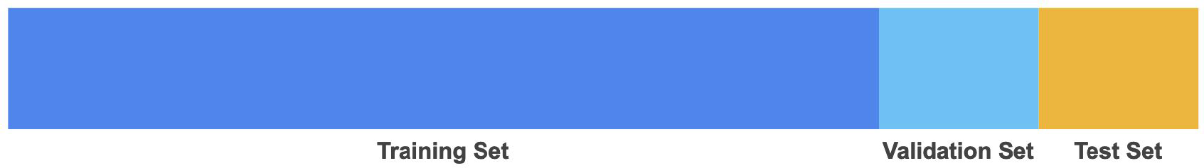
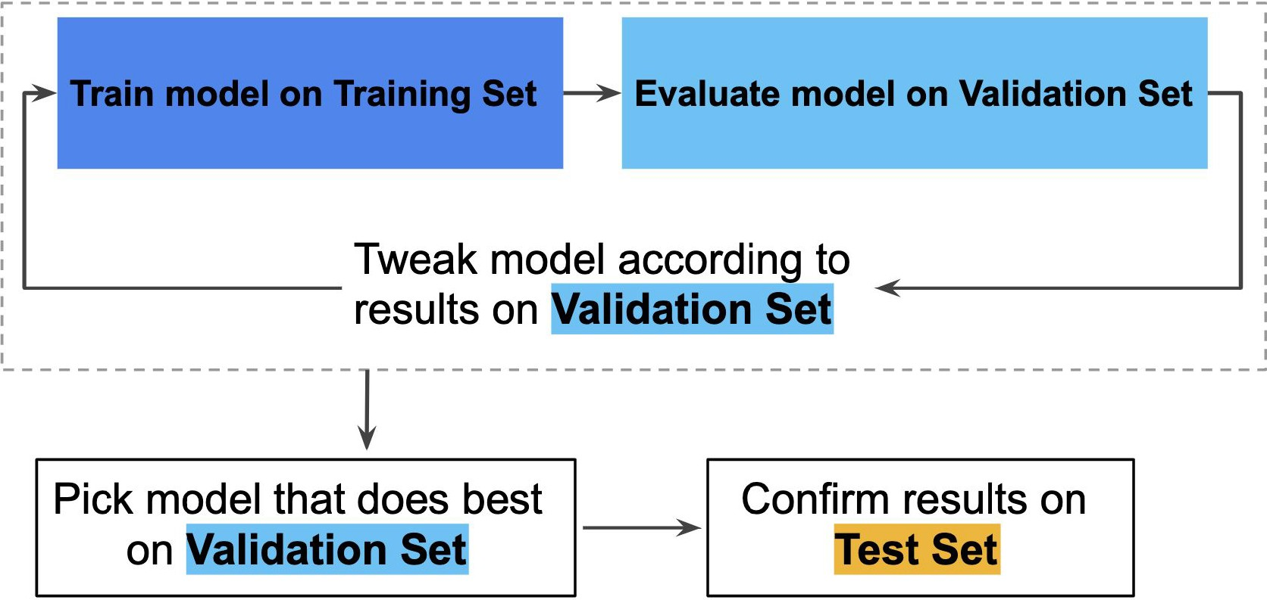
Partitioning the data

Slide 17
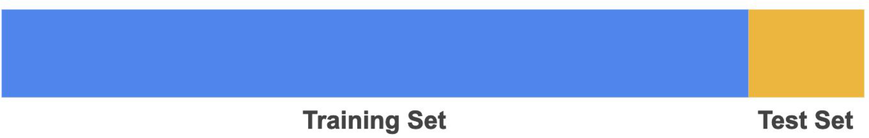
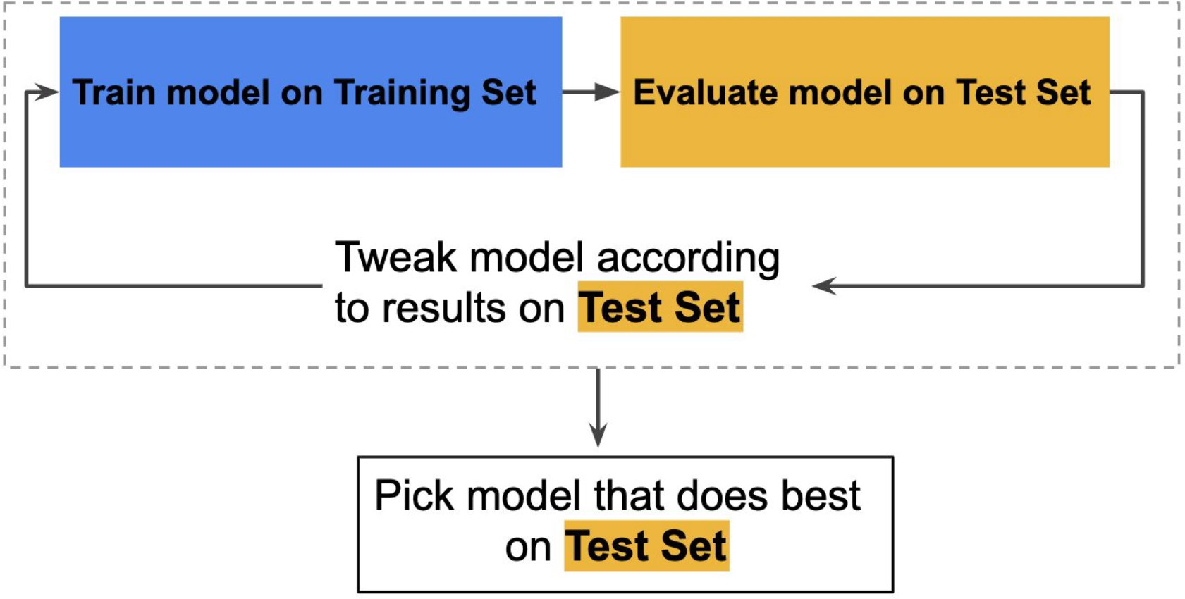
Partitioning the data (WRONG)
Problem:
Overfitting on the Test dataset

Slide 18

Decision Trees
How to pack groceries?
Tomatoes, soft vegetables
Wine, fragile items
Bread
Toiletries, shampoo
Meat, fish

Slide 19
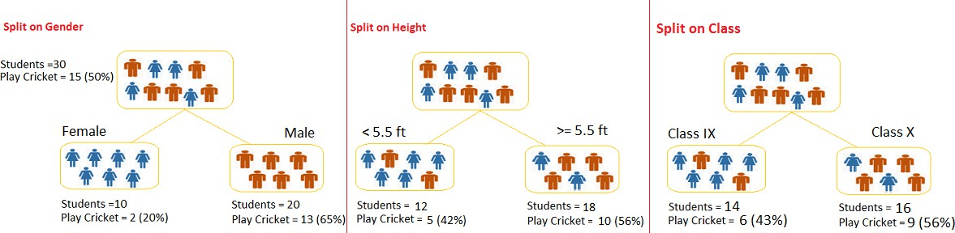
Decision Trees

Slide 20
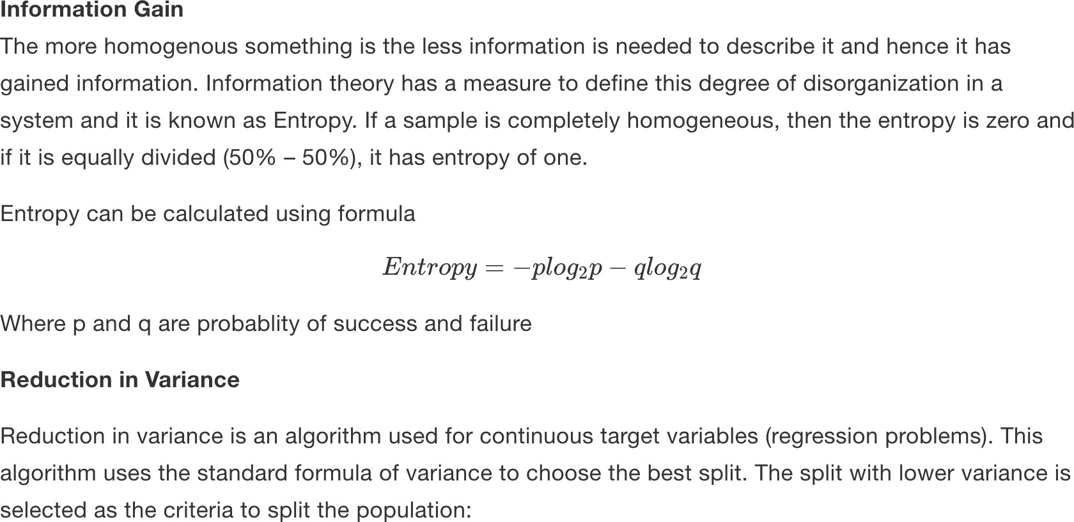
Decision Trees. Splitting decision

Slide 21
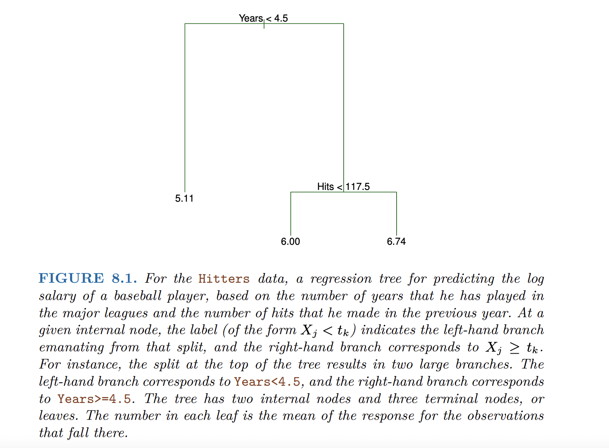
Decision Trees
Notes:
Years is the most important feature (and previous hits does not matter that much)

Slide 22
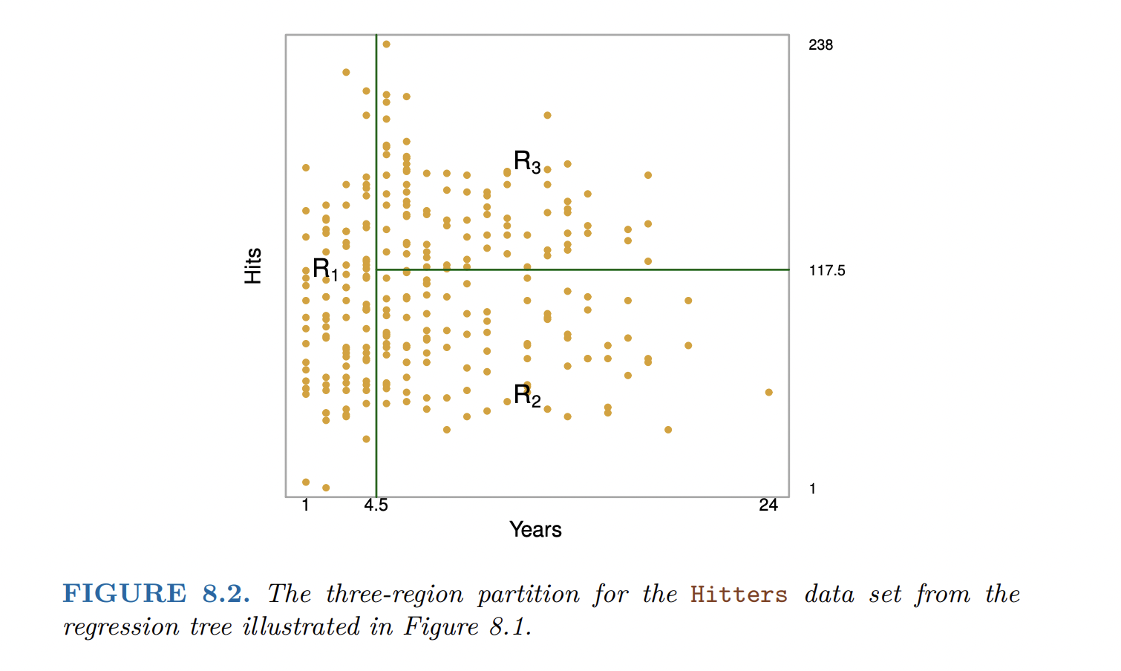
Decision Trees
An Introduction to Statistical Learning with Applications in R

Slide 23
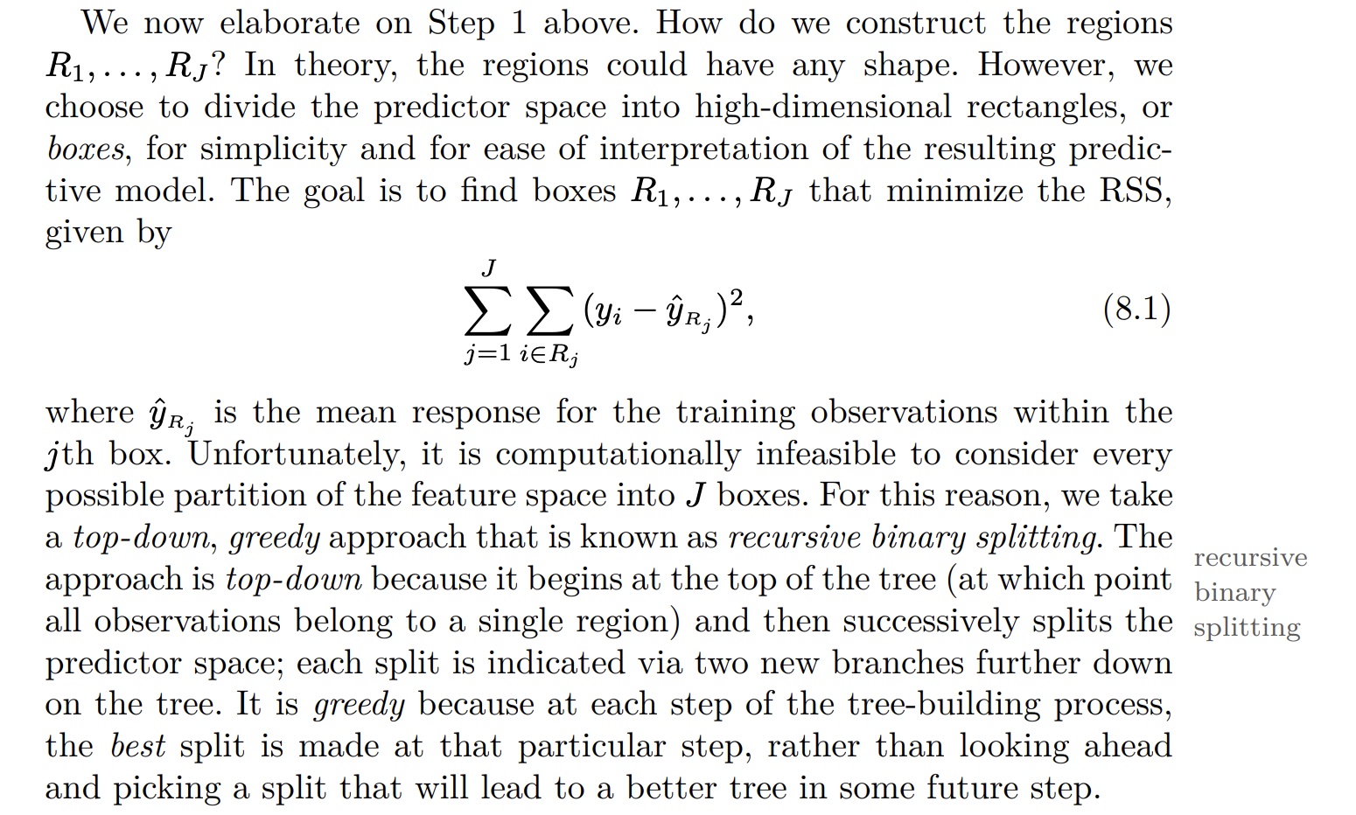
Decision Trees

Slide 24
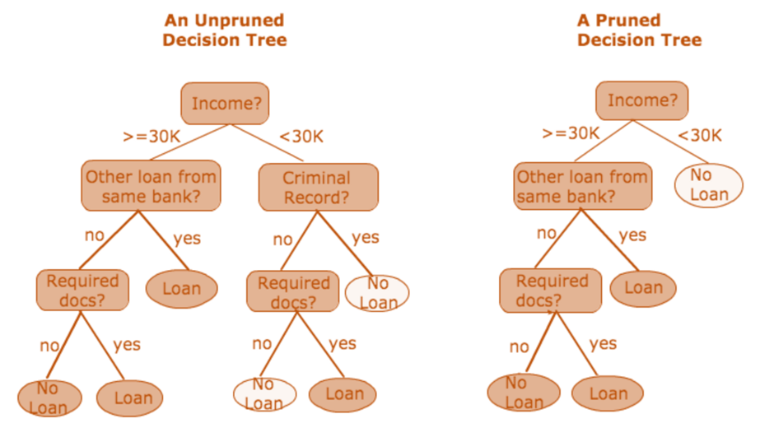
Decision Trees: how to get smaller trees
https://medium.com/@ompramod9921/decision-trees-8e2391f93fa7

Slide 25
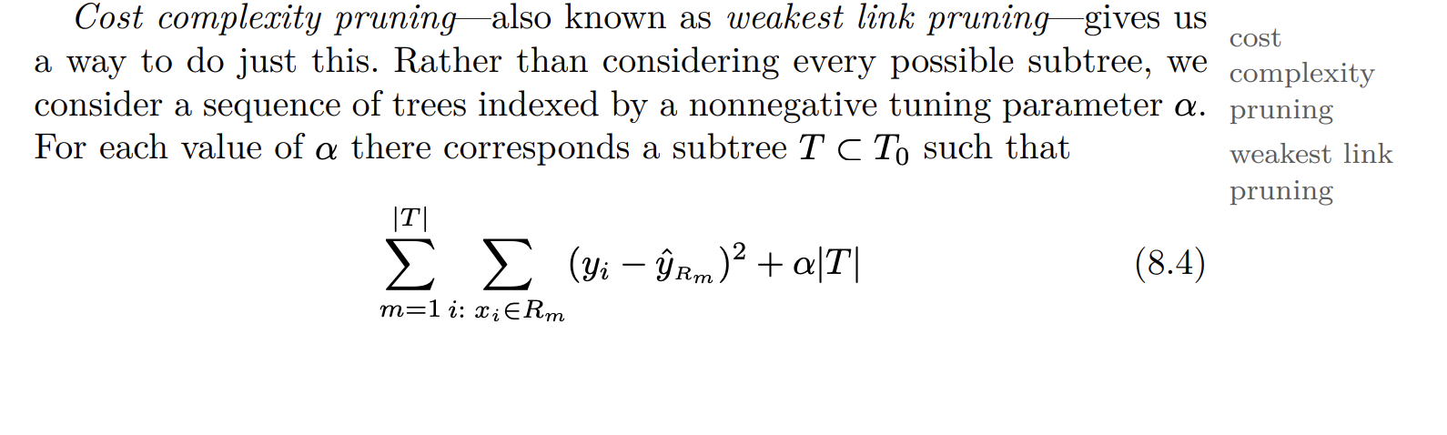
Decision Trees: how to get smaller trees
An Introduction to Statistical Learning with Applications in R

Slide 26
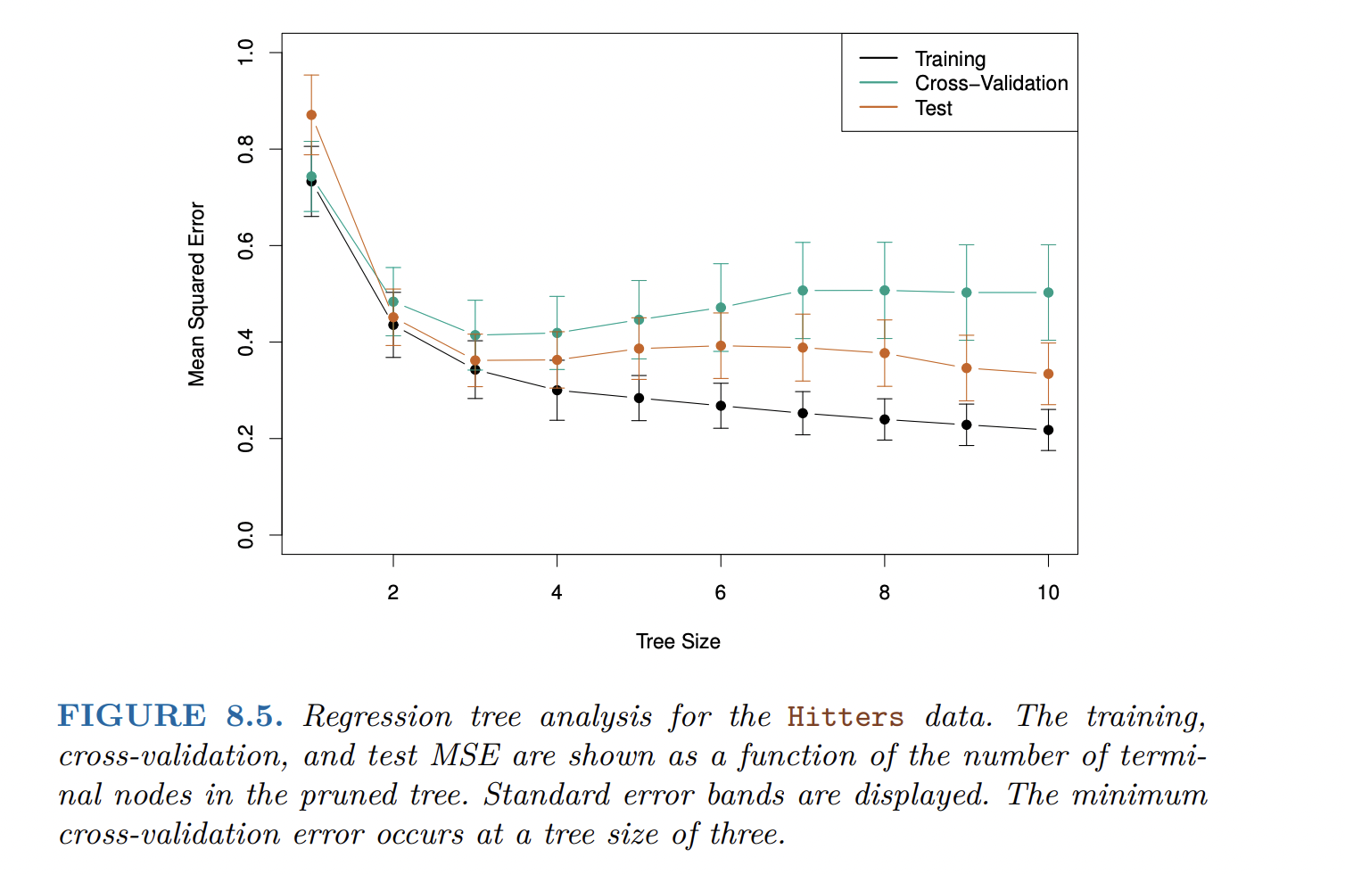
Decision Trees

Slide 27
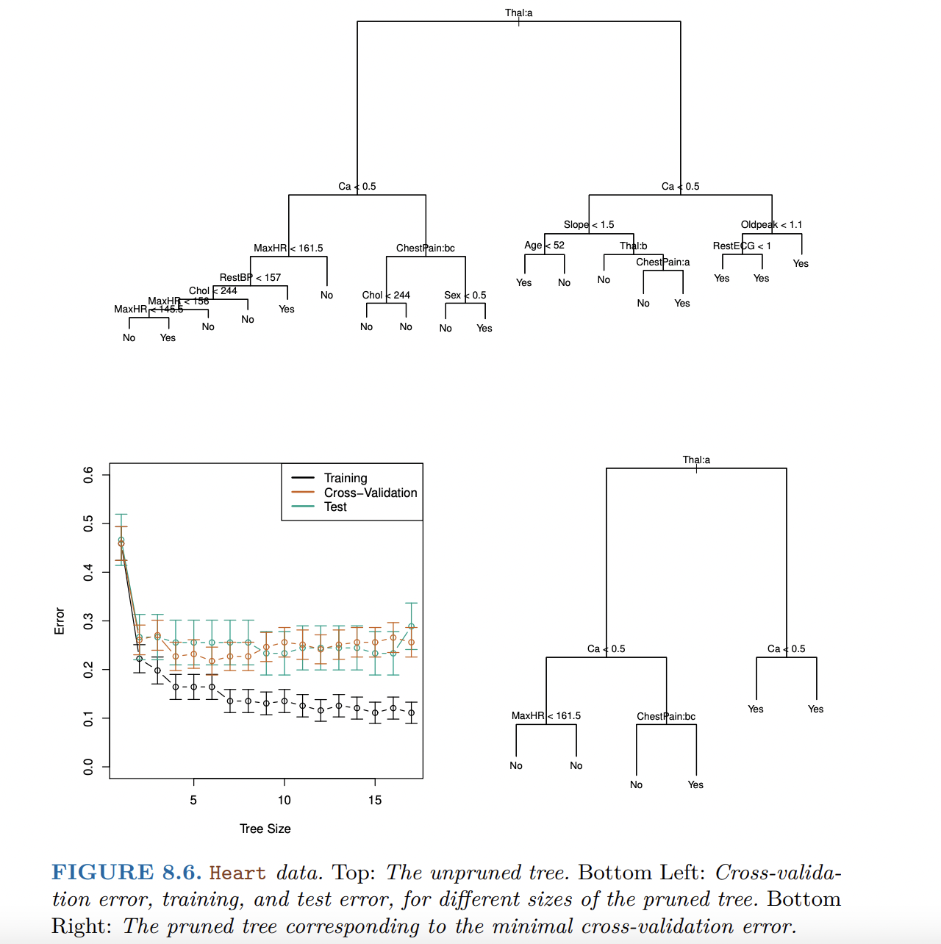
Classification trees

Slide 28
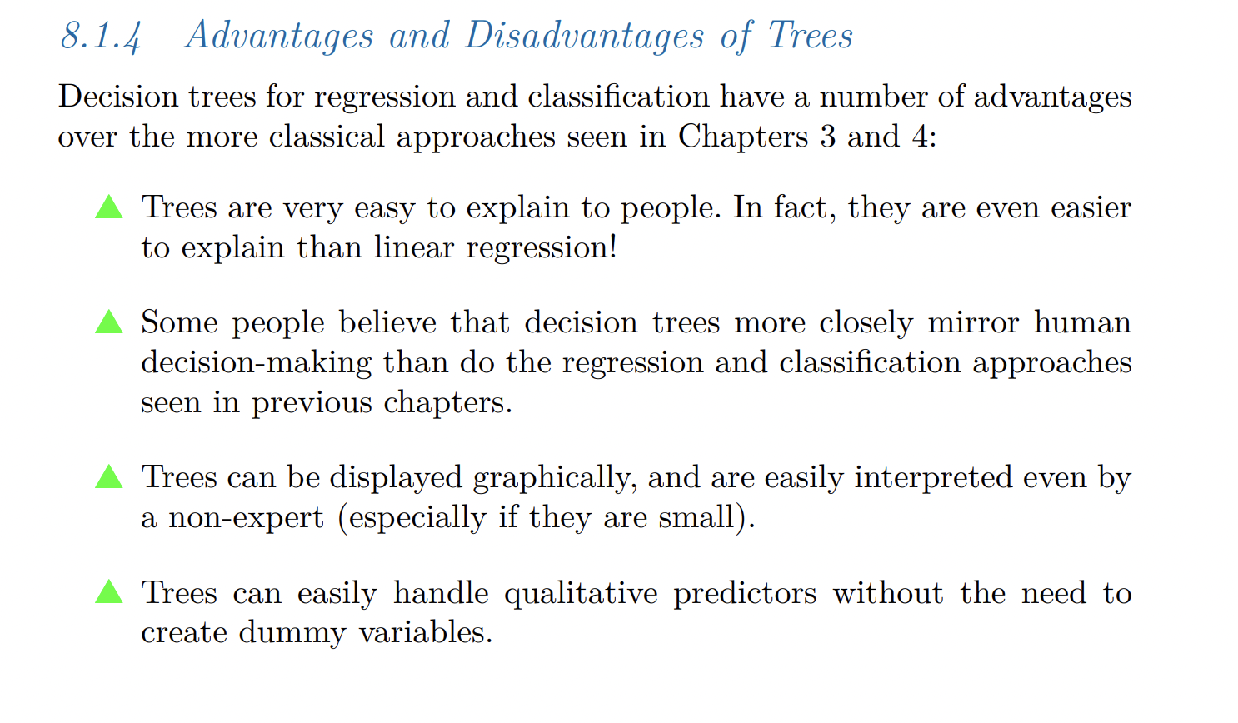
Pros and cons of trees
An Introduction to Statistical Learning with Applications in R

Slide 29
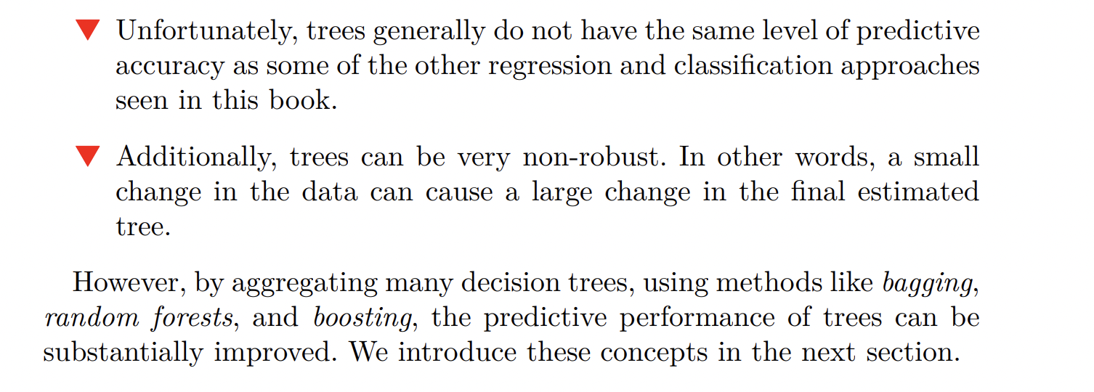
Pros and cons of trees
An Introduction to Statistical Learning with Applications in R

Slide 30
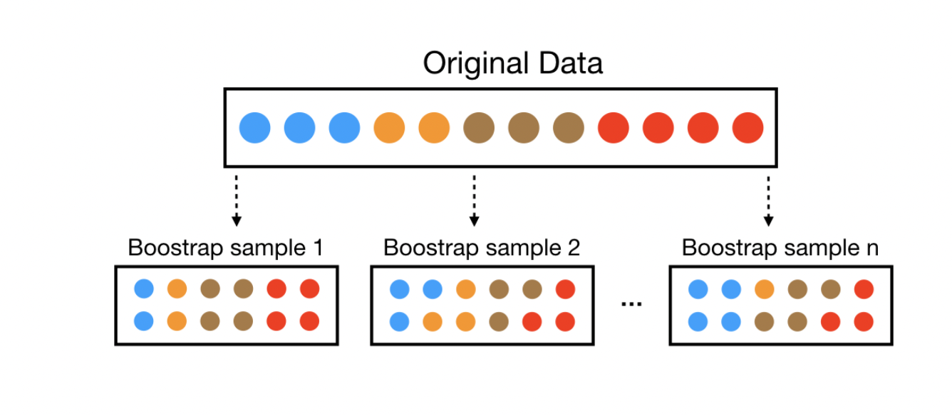
Bagging
https://bradleyboehmke.github.io/random-forest-training/slides-source.html#33

Slide 31
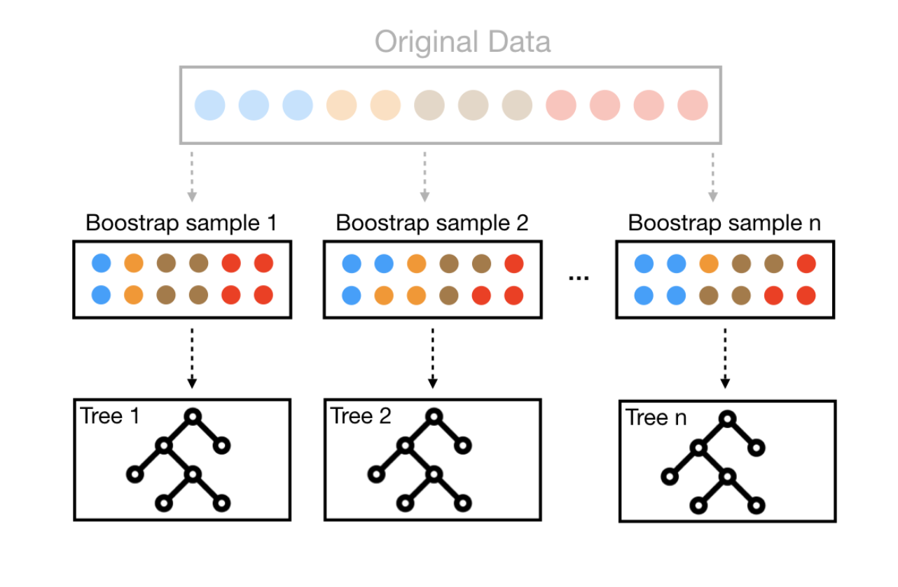
Bagging
https://bradleyboehmke.github.io/random-forest-training/slides-source.html#33

Slide 32
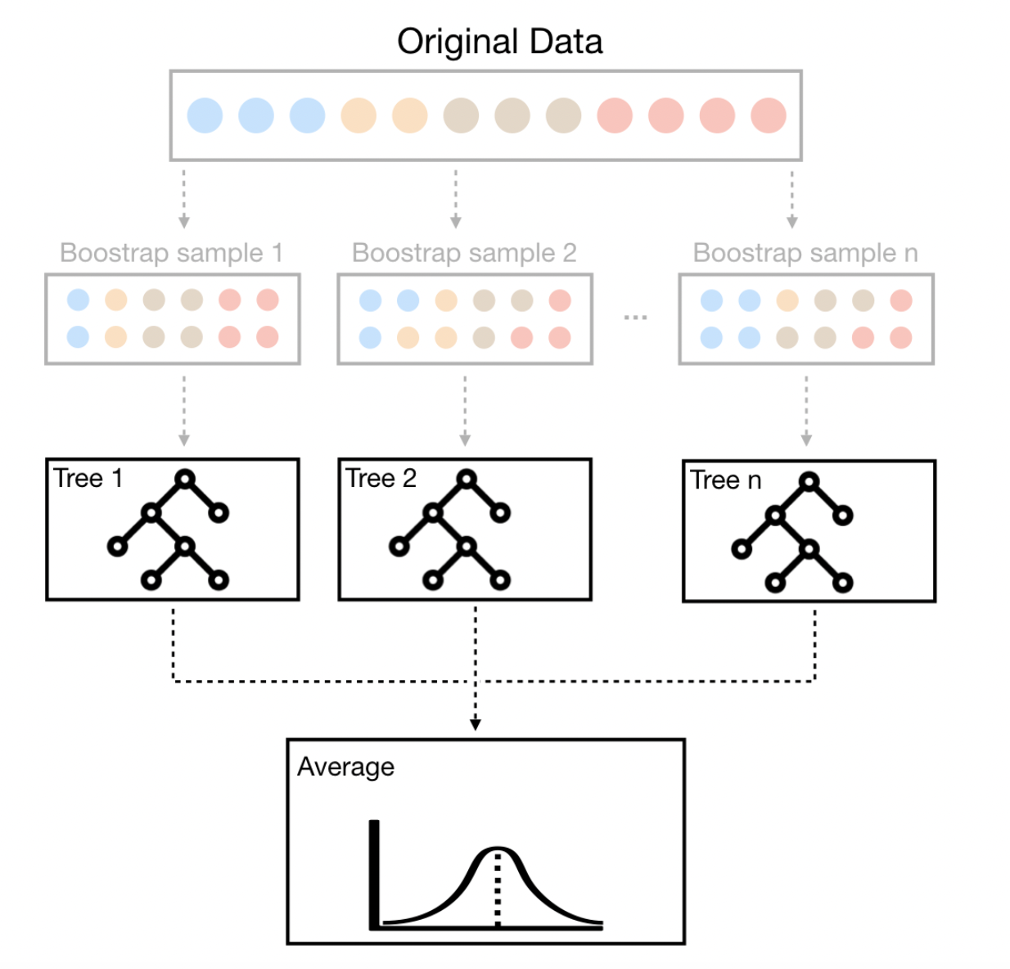
Bagging
Can this lead to any problems?

Slide 33
Random forests + Bagging
Decorrelate trees
When deciding on a split, a random sample of features is taken
Each tree is built on a different random sample of features!

Slide 34
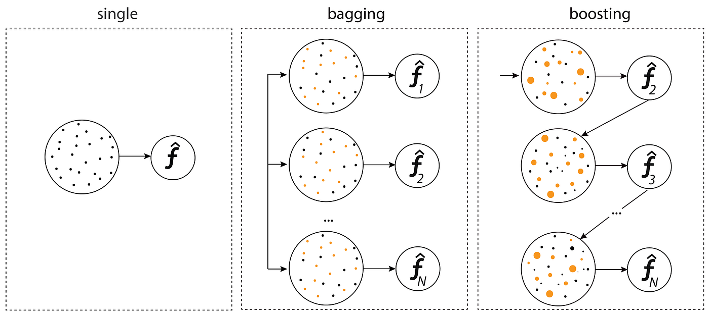
Random Forests (Bagging vs. Boosting)
https://medium.com/@senozanAleyna/ensemble-boosting-bagging-and-stacking-machine-learning-6a09c31df778
Notes:
Why bagging may lead to problems

Slide 35
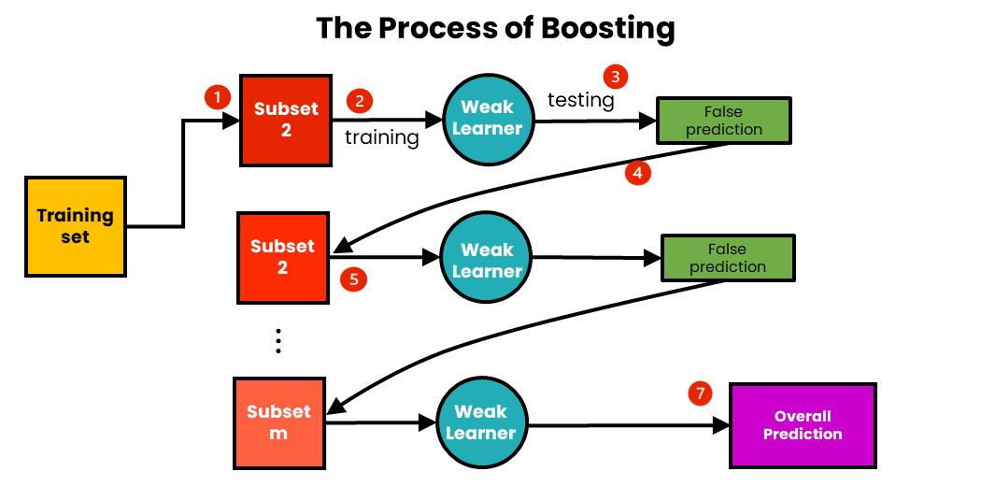
Random Forests (Boosting)
https://medium.com/@brijesh_soni/understanding-boosting-in-machine-learning-a-comprehensive-guide-bdeaa1167a6
Notes:
Why bagging may lead to problems

Slide 36
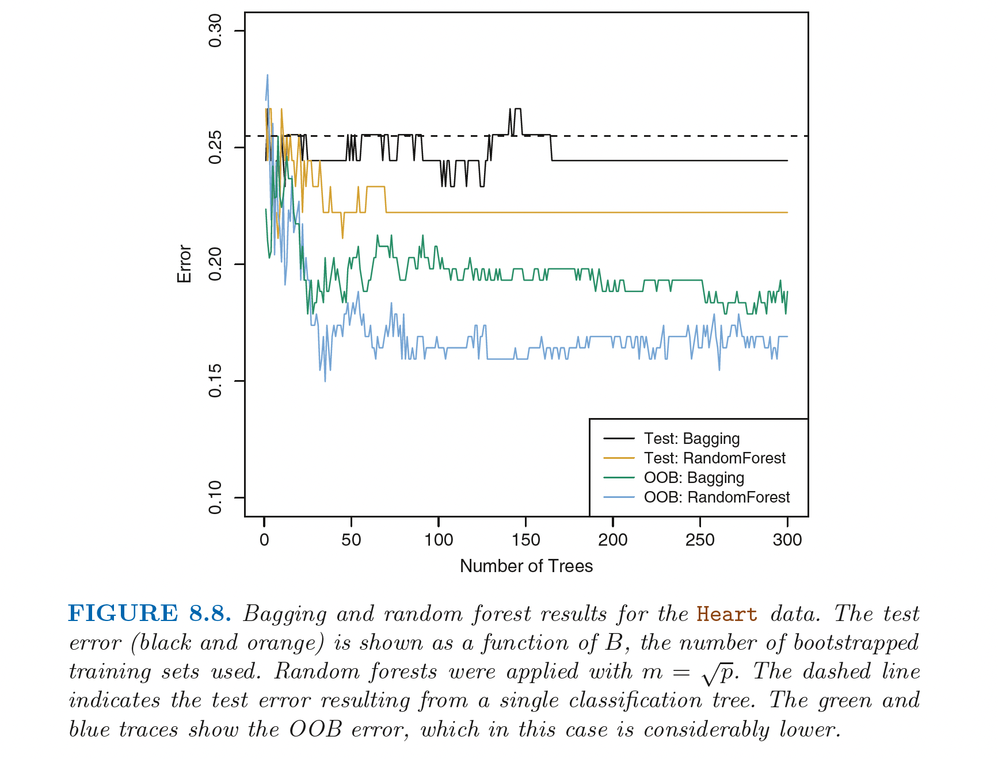
Random Forests (PRACTICAL)

Slide 37
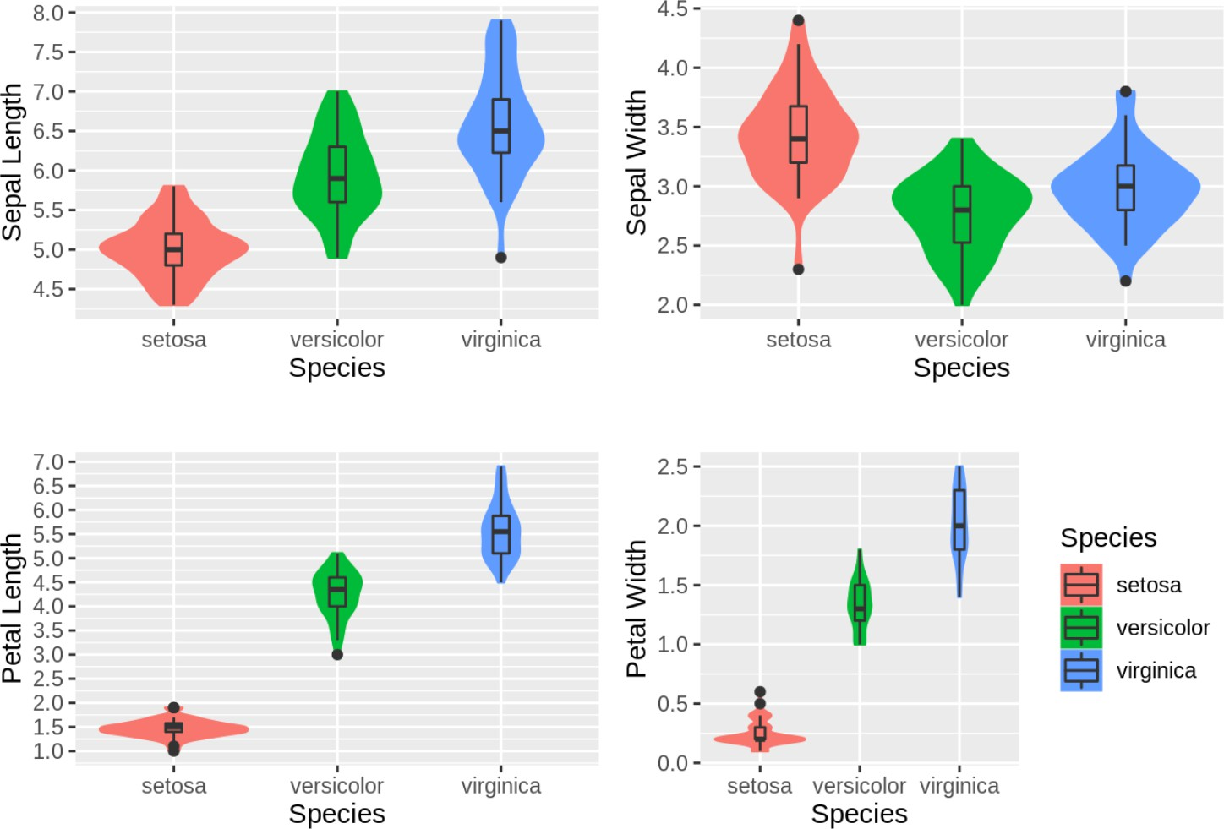
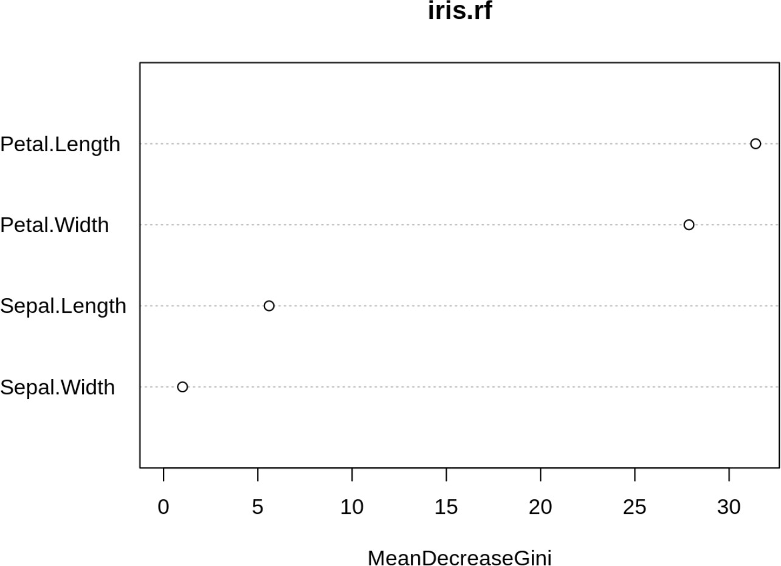
Random Forests: Variable Importance (PRACTICAL)

Slide 38

Artificial Neural Networks
Iterated logistic regression
https://saedsayad.com/logistic_regression.htm

Slide 39
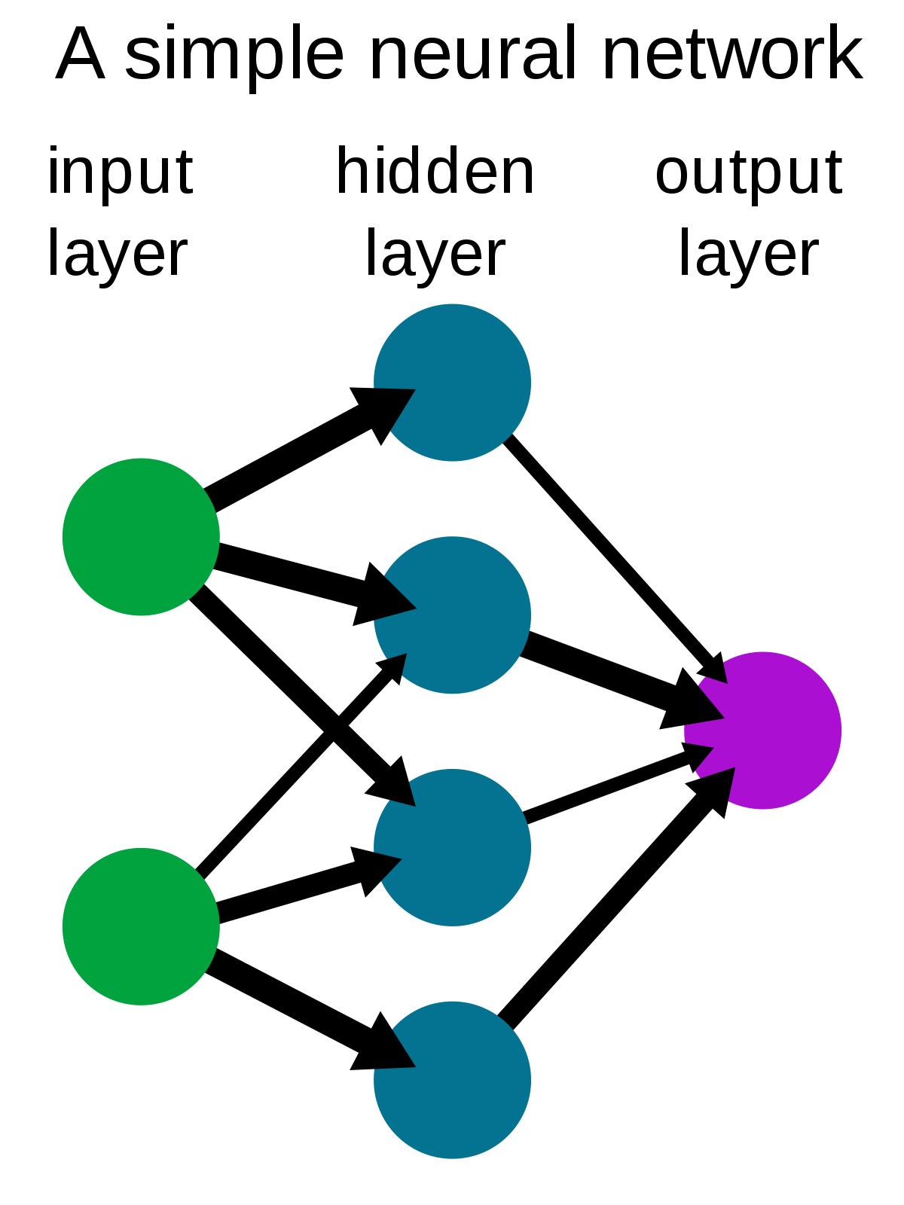
Artificial Neural Networks
Iterated logistic regression
https://en.wikipedia.org/wiki/Neural_network#/media/File:Neural_network_example.svg
Notes:
Link to deep neural nets and large language models

Slide 40
A fundamental concept in machine learning
Notes:
One thing I want you to memorize; please commit this to memory

Slide 41
A fundamental concept in machine learning
An Introduction to Statistical Learning with Applications in R

Slide 42
Hypothesis
West et al., Nature Medicine, 2017
Notes:
What happens if we use a simple classifier that just predicts randomly on a disease? For example, say you are trying to predict a particular disease. Each person has for each person. Assume you have features like age, gender and medications. You have to predict whether this patient will get a disease or not. As even the disease occurs in 90% of the population. How should you build your algorithm? What metric should you look at?
Answer: You should look at class-specific error (sensitivity/specificity). This is unbalanced data. Even an algorithm that randomly outputs 1 that is the person has disease, regardless of the input features, would give a 90% accuracy on the data.

Slide 43
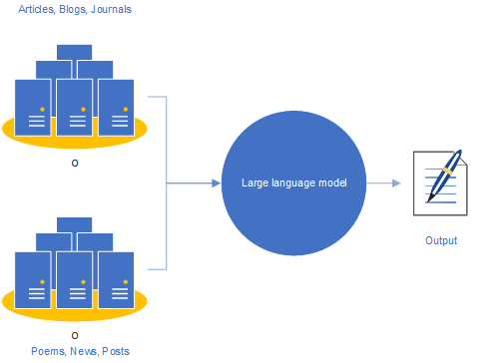
Applications of this concept
I saw a cat on a …
mat
https://becominghuman.ai/a-quick-introduction-to-the-large-language-model-chatgpt-a2f5f54b4d5e
Notes:
Say you are working in a startup and you have created a new model …… gizillions of parameters and less data. How would you …..

Slide 44
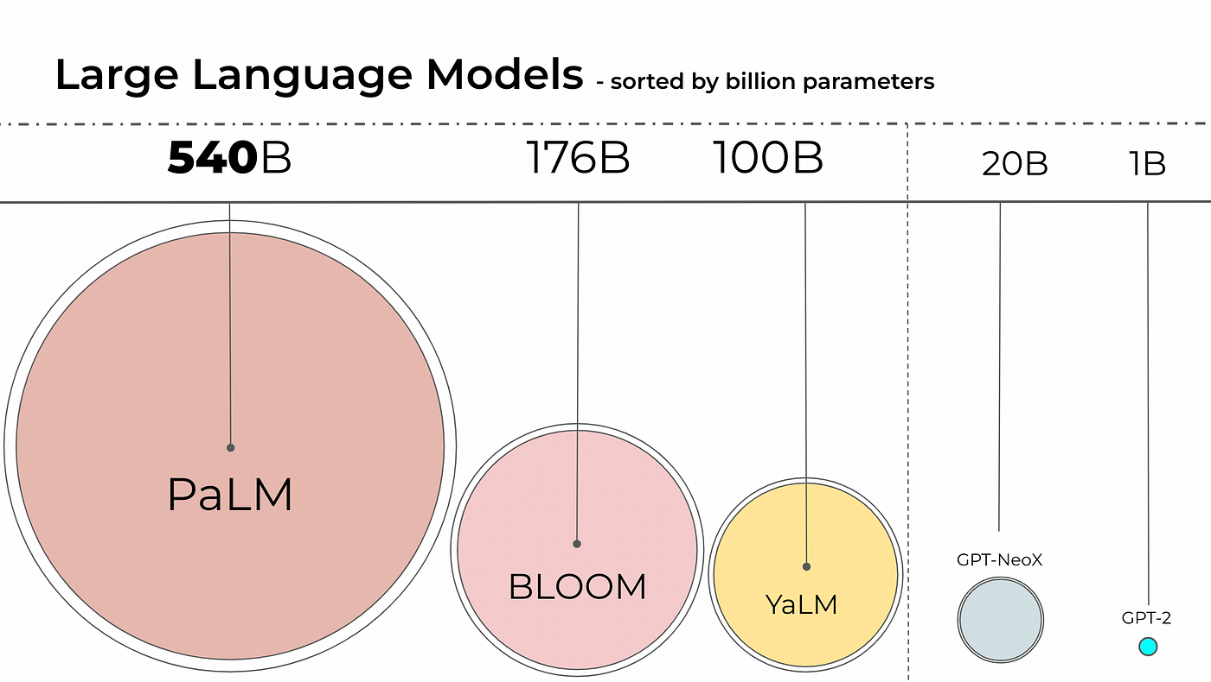
Applications of this concept
https://ashukumar27.medium.com/decoding-large-language-models-quantization-ff58964c0f31

Slide 45
Resources
https://www.statlearning.com/
Free PDF of book and R code
https://www.statlearning.com/resources-second-edition
More practical tutorials and R code
https://cambiotraining.github.io/intro-machine-learning/

Slide 46
Questions

